Slide 1
CST2208 – Statistical Topics for BISI Students Overview
Dennis Buttera – Advanced Studies Advisor
Centre for Advanced Studies, IBM Canada Lab
11 January 2016

Slide 2

Course Purpose
… extend the knowledge by considering methods appropriate for more complex requirements, including an introduction to and use of analytical techniques and natural language processing for mining of unstructured data.

Slide 3
One Course – 4 Tools
SPSS Modeler
SPSS Statistics
Watson Analytics
Bluemix

Slide 4
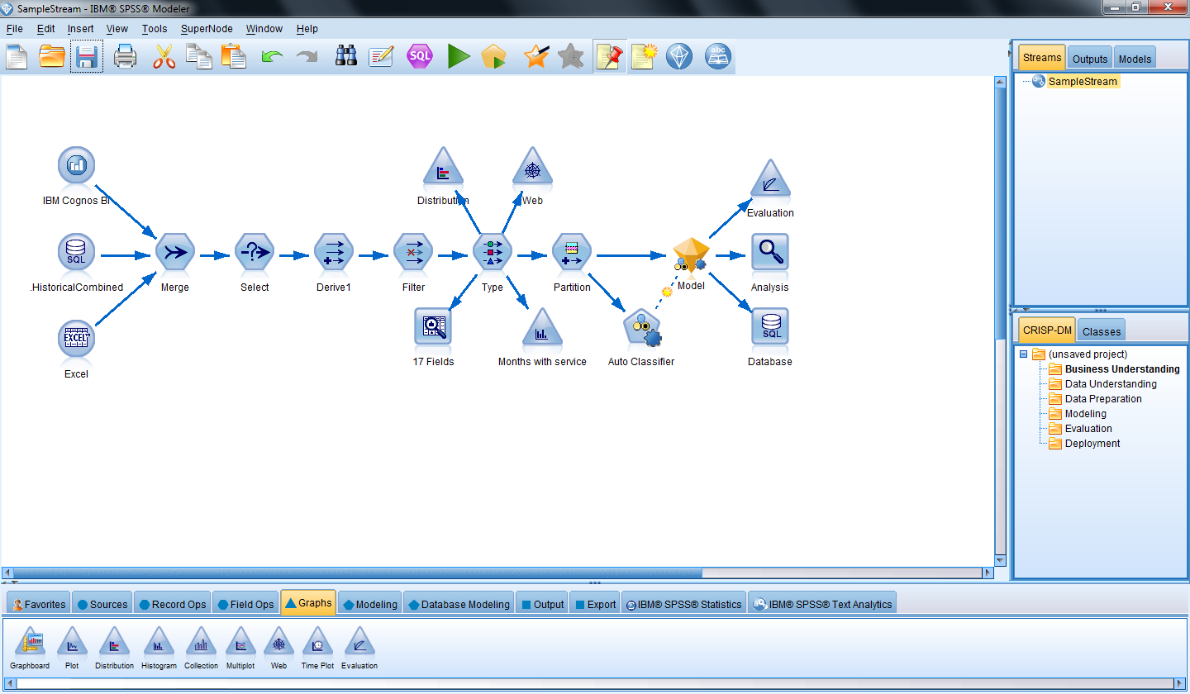
IBM SPSS Modeler
Predictive analytics platform
Improve outcomes through predictive intelligence
Flexible adoption and configuration -- on premises, in cloud, and everything in between
Scale from personal usage, point solution(s) to enterprise deployment
Providing a range of advanced analytics - decision management, text analytics, entity analytics, social network analysis and optimization.
Notes:
IBM SPSS Modeler is a predictive analytics platform, designed to bring predictive intelligence to everyday business problems, enabling front-line employees or systems to make more effective decisions and improve outcomes. Modeler scales from desktop installations through to larger deployments that are integrated within operational systems and provides a range of advanced analytics including text analytics, entity analytics, social network analysis, automated modeling and data preparation in addition to decision management and optimization.
The POINT
This enables organizations to improve business processes and help people or systems consistently make the right decisions by delivering recommended actions at the point of impact. The result is a rapid ROI and the ability to proactively and repeatedly reduce costs and increase productivity.
Put in the modeller and statistics working together – top down/bottom up analysis, working together – and the amount of capabilities increase!
Application Examples
IBM Crime Prediction and Prevention
IBM Predictive Tax Fraud Detection and Prevention
Retail Predictive Maintenance
Retail Assortment Planning
Retail Market Basket Analysis

Slide 5
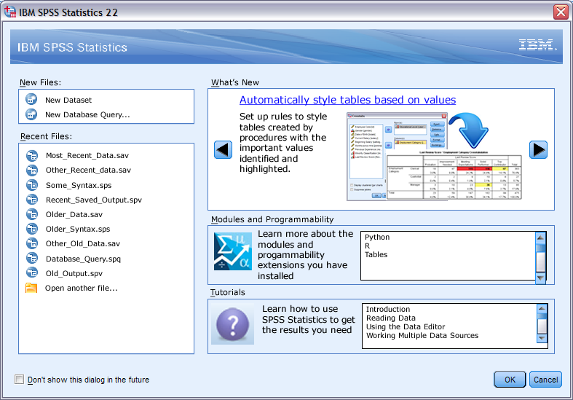
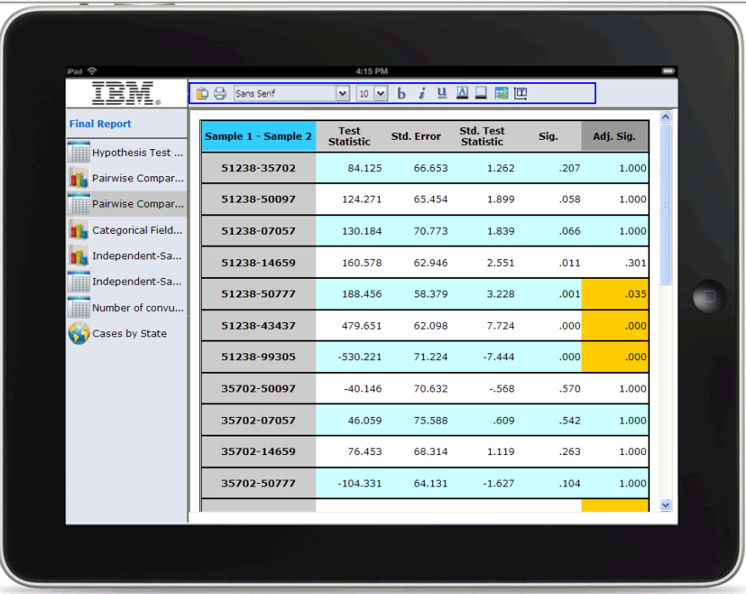
IBM SPSS Statistics
Advanced statistics and data management for professional analysts and data scientists
Easy to use and fully features to support a faster time to value and a shorter learning curve
Provides insight into a sample of data and tools for prediction and forecasting based on the data
Programmability for advanced users that leverages common statistical programming languages in the market (Python, R)
5
Notes:
5
5
5
IBM SPSS Statistics
Provides advanced statistics and data management for analysts researching business problems and/or questions.
It allows for the collection, analysis, interpretation, explanation, and presentation of data.
It can be used to provide insight into a sample of data and provides tools for prediction and forecasting based on this data.

Slide 6

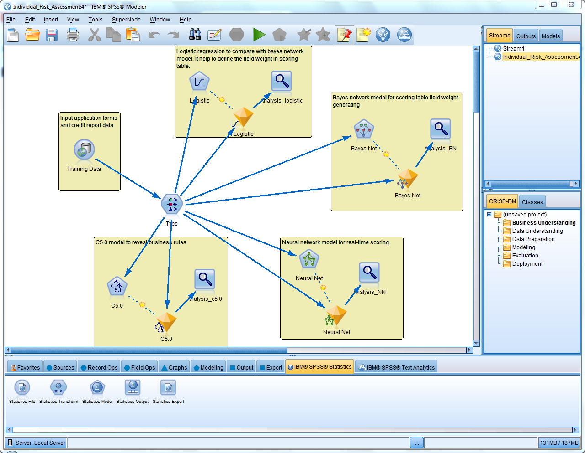
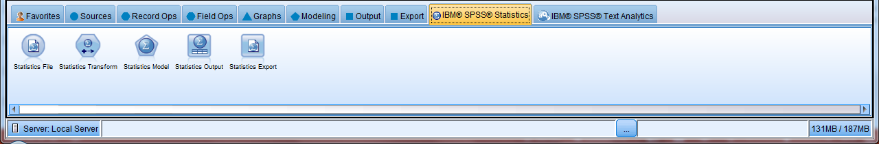
Common Questions?
Which product do I need if I want to do “predictive analytics”?
Which product do I need if I run to do a regression analysis?
Which product do I need to understand the drivers for my outcome?
Which product do I need to build a predictive model?
…. And so on
IBM SPSS Modeler & Statistics are both useful to an organization looking to make sense of data and are designed to do so
Notes:
Because both IBM SPSS Statistics and IBM SPSS Modeler perform advanced analytics, there is sometimes confusion as to “what do I use?”
This is complicated by the fact that at first glance – it seems that the products do the same, or at the very least similar, kinds of analytics
BOTH are useful to organizations that are looking to make sense of their data and the products are designed to work together. The Modeler interface for a user that has both Modeler and Statistics. That user can leverage all of the Statistics capabilities as part of the analytical stream – and there is good reason to do so.

Slide 7
Statistical Analysis & Data Mining: Feeding Predictive Analytics
Top-Down Approach
Bottom-up Approach
A statistical approach involves
forming a theory about a possible relationship
converting it to a hypothesis
testing that hypothesis using statistical methods
It is a manual, user-driven, top-down approach to data analysis
Data mining involves the interrogation of the data and is performed by the data mining method rather than by the user
It is a data-driven, self-organizing, bottom-up approach to data analysis that works on very large data sets
Source: DM Review
“Statistical Modeling: The Two Cultures,” Leo Breiman, Statistical Science, 2001, Vol.16 (3), pp.199-231.
Note that Both Approaches can Drive Predictive Analytics
Notes:
Both approaches – statistical analysis AND data mining – drive predictive analytics. Both are needed.
Statistics takes a top down approach – a theory is formulated about what is happening in the data, the statistical procedures allow the user to test that theory and find confirmation for it, and the findings are then summarized for other stakeholders.
Modeler takes a bottom up approach – that is, users are exploring data for patterns using algorithms that encapsulate multiple statistical procedures to confidently predict the future. The result is a model that can be deployed – which means the logic of the drivers is now encapsulated and can be used to automate a process intelligently, or to provide a person with a recommendation, or much more

Slide 8
Consider the following …
IBM SPSS Modeler | IBM SPSS Statistics
Are you looking to build a predictive model? | Are you interested in applying statistical tests to data, distribution, mean, median, mode?
Are you working with enterprise data stores more so than files? | Are you currently using spreadsheets for your analysis?
Are you looking to analyze both structured and unstructured data? | Are you creating reports that highlight statistical differences between groups?
Are you looking to understand underlying data relationships in a controlled way using algorithms? | Are you testing hypothesis and cause and effect using statistics?
Are you looking to predict an outcome such as retention, resource usage, marketing response? | Are you looking at statistical relationships such as correlation, confidence levels?
Do you work within a team that is mostly business analysts? | Do you work within a team that is mostly statisticians?
Are you looking to create models that are deployed (automated, integrated, etc.)? | Are you using statistical analysis to create output (reports, presentations, etc.) for others?
Are you looking for a fully-featured, comprehensive solution to your data challenges that incorporates a full breadth of data preparation, statistical analysis, data mining and more in a visual interface that was created to address the needs of multiple users and allow the business, the analyst and the developer to understand and work with each other in a collaborative environment.
Notes:
When you are speaking to customers/prospects…certain questions can help drive you towards a better fit for Modeler or Statistics
However, ultimately – the goal is to position the full capabilities and encourage our customers to adopt both. With new packaging options, and the ability to beta both together, this is easier than ever before.

Slide 9


Statistical Analysis Supports Data Mining (and vice versa)
Ad-hoc analysis
Hypothesis and model testing
Data preparation
Data understanding
Descriptive statistics
Statistical analysis
Machine learning
Scoring
Data mining
Deployment at scale
Non-linear and iterative
Automation and integration
Notes:
This visual summarized the relationship between statistics and data mining and what each provides to the analytical process. To re-iterate the point, both products support the process of predictive analytics and the synergies between them provide the biggest value to our customers.

Slide 10










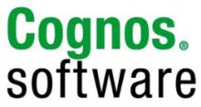



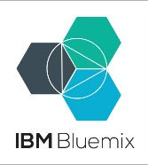
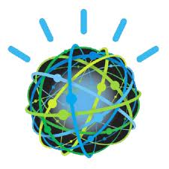


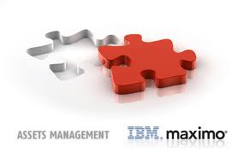
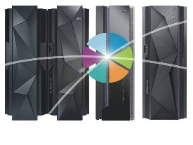


Predictive Product & Solution Portfolio
Predictive Maintenance and
Quality (PMQ)
Predictive Customer Intelligence (PCI)
Counter Fraud Management (CFM)
Custom Applications
Differentiated Analytic Solutions
Think Synergy!
Data Collection
Statistics
Modeler and ADM
Analytic Server
Decision Optimization
Watson Analytics
Collaboration and Deployment Services
Notes:
Now let’s focus our attention on IBM’s platform for advanced analytics – which is a set of integrated capabilities that are part of the IBM SPSS portfolio
This powerful analytical foundation provides the predictive engine that drives Watson – but is also a core component of analytical solutions – some of which have been packaged, and others that can be configured to suite the need of any organization that has data.
The products here provide the following capabilities:
Data Collection – for creating powerful surveys that people want to complete, capturing the opinions, preferences and attitudes of people that is often not available through any other means
Statistics – for ad-hoc data analysis and data preparation
Modeler (with Analytic Decision Management) – for creating repeatable, deployed predictive analytics
Analytic Server – for taking predictive power to Big Data
Decision Optimization – for finding the best decision when faced with complexity of choice
..and the glue of Collaboraiton and Deployment Services that can tie these capabilities together and further connect them to the broader IBM ecosystem
Now…for those not familiar with the porfolio, let’s dive deeper into the key products.

Slide 11



Combining IBM Watson Analytics & IBM SPSS
Predictive Exploration for the Business
Built for the novice analyst/business user
Individual discovery in the cloud
Freemium model
Personal data
Apply Statistical Thinking
Built for an analytical professional
Sophisticated statistical analysis backed by reporting capabilities
Supports the entire analytical cycle
Research data
Embed Predictive Analytics into Enterprise Functions
Built for the professional analyst and data scientist
Sophisticated predictive capabilities for all data
Optimizes business processes in real-time
Enterprise data
Notes:
IBM Watson Analytics
IBM Watson Analytics sets powerful analytics capabilities free so practically anyone can use them. Automated data preparation, predictive analytics, reporting, dashboards, visualization and collaboration capabilities, enable you to take control of your own analysis. You can then take the appropriate action to address a problem or seize an opportunity, all without asking IT or a data expert for help.
Get better data. Data access, refinement, management and analysis are automated and available from the cloud.
Get answers. Ask questions in the terms of your business, whether you're in marketing, sales, HR, finance or operations.
Understand your business. Automated intelligence enables you to draw conclusions based on what has happened and why.
Tell a story. Visualizations help you create clear and compelling infographics to prove your point confidently.
Think ahead. Statistical analysis, correlations and predictions help you see what is likely to happen and what you can do about it.

Slide 12
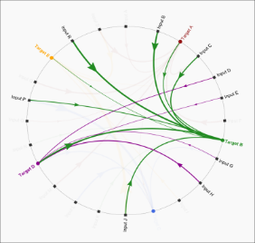
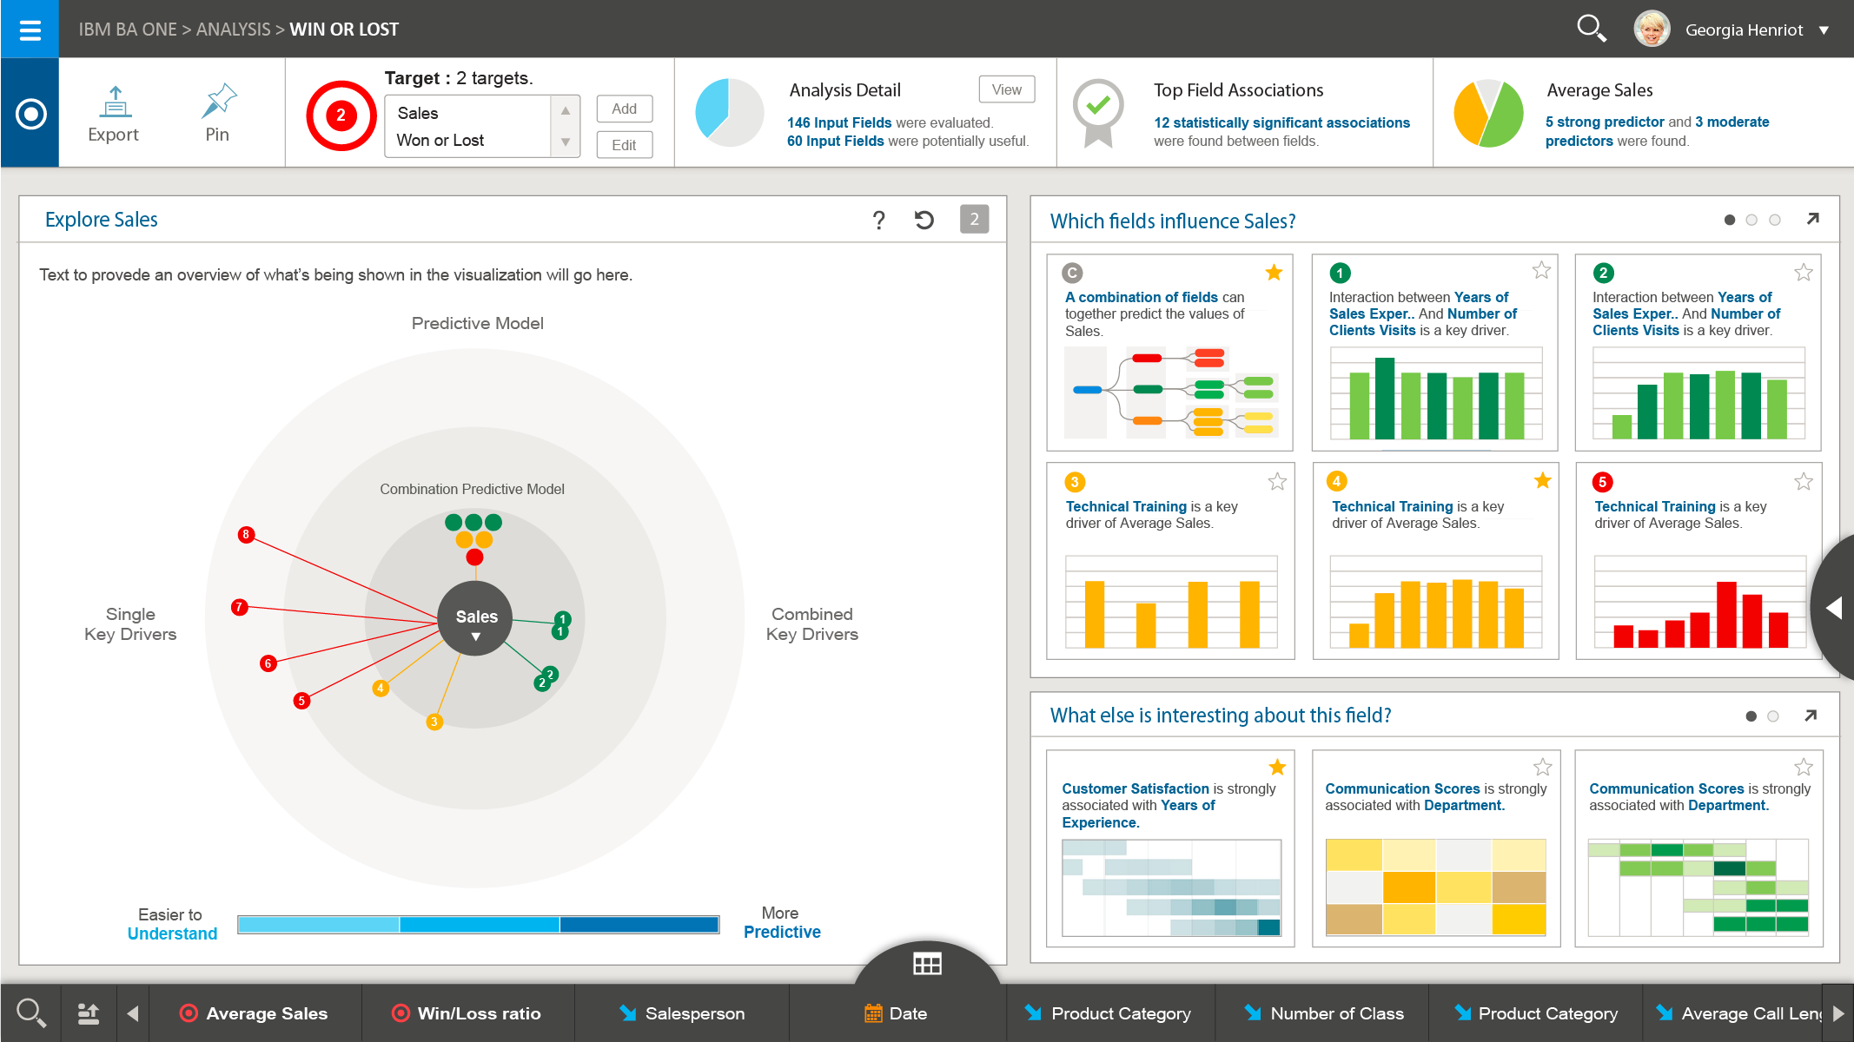
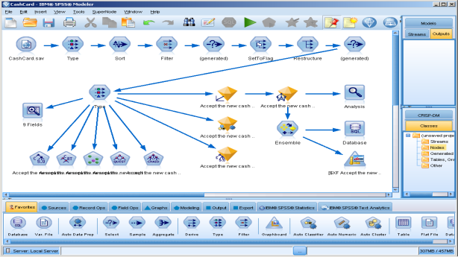
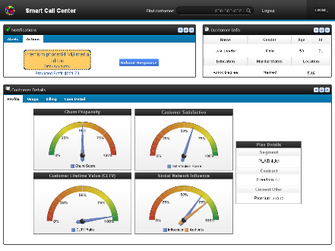



A smooth path from analytical discovery (IBM Watson Analytics) to enterprise-scale, embedded analytics
Extend
Collaborate
Transition
Basic predictive capabilities for the business. Go beyond spreadsheets and quickly explore data in the context a business can understand
Meaningful analytics that a novice begins and an expert builds upon. Bring business led insights to decision makers and advanced analysts.
From discovery to rich story telling capabilities, embed predictive findings into decision management models for optimal business efficiencies.
Notes:
Create predictive analyses using IBM Watson Analytics
Describe and explain the architecture and services offered by cognitive computing / machine learning systems (e.g., IBM Watson Analytics ) that can assist suitably trained users develop big data applications that analyze large volumes of data, process natural language queries, and generate evidence-based results;
Describe and explain how the above services are linked to underlying tools (e.g., SPSS, R, etc.);
Develop, describe and explain the important business environment / setting / context variables, and drivers that influence and / or determine the appropriate technical analytic process to adopt, and create user confidence in the process and results;
Demonstrate competency in the use of identifed main features / services in a specified leading technical / marketplace advanced analytics software system.

Slide 13
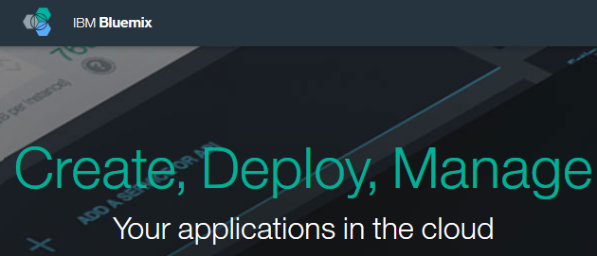
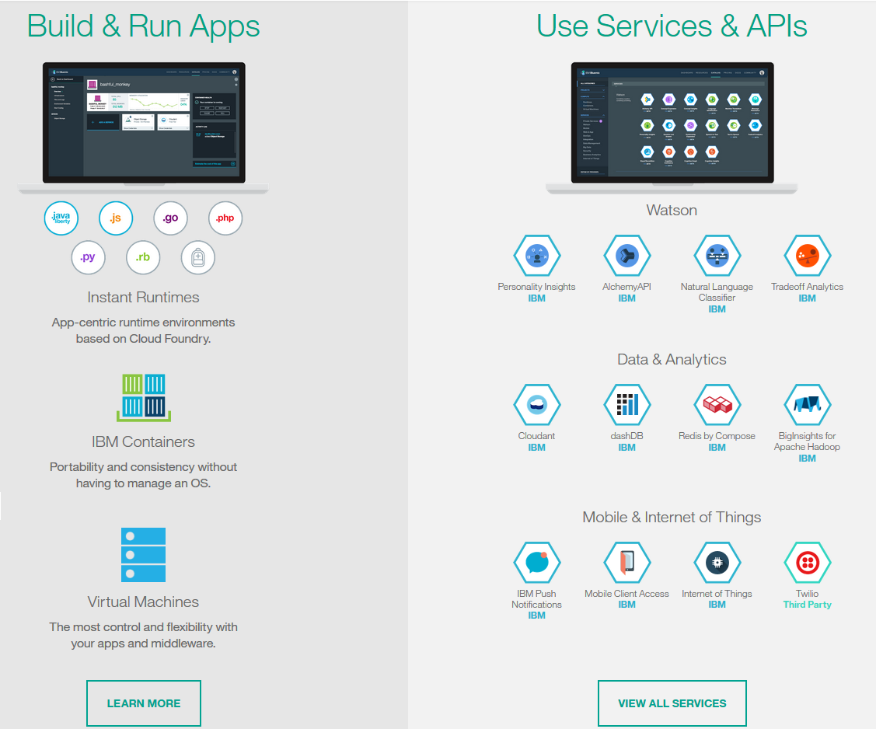
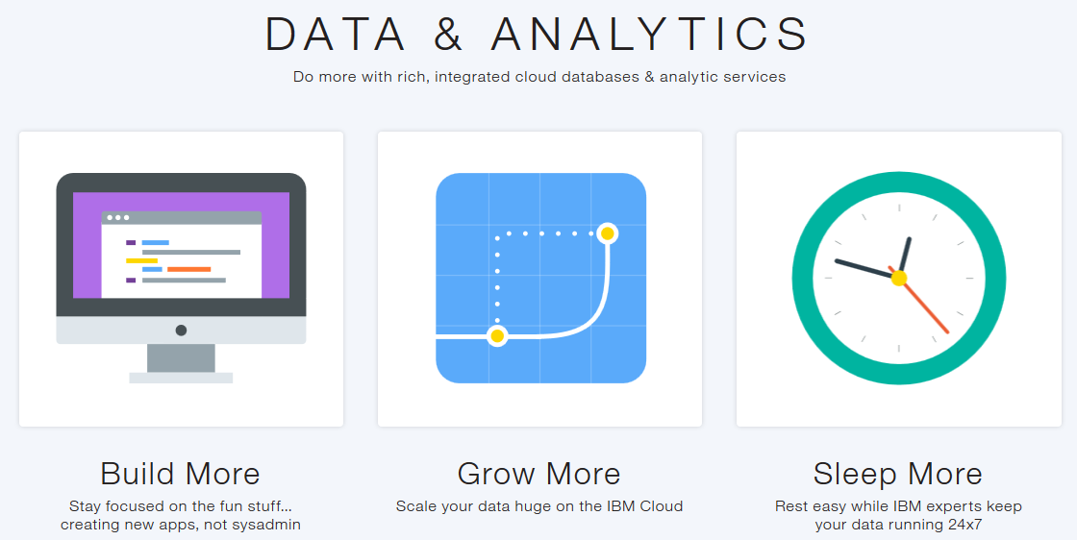
IBM Bluemix Cloud Applications
an open-standards, cloud platform for building, running, and managing applications
developers focus on building excellent user experiences with:
flexible compute options,
choice of DevOps tooling, and
IBM and third-party Application Programming Interfaces (APIs) and services
Notes:
IBM Bluemix is an open-standards, cloud platform for building, running, and managing applications.
With Bluemix, developers can focus on building excellent user experiences with flexible compute options, choice of DevOps tooling, and a powerful set of IBM and third-party Application Programming Interfaces (APIs) and services.

Slide 14
IBM Bluemix Cloud Applications
Create predictive analyses using IBM BlueMix Cloud Applications.
Describe and explain the role of cloud services
Develop, describe, demonstrate, explain and present analytic applications using Twitter feeds, Natural Language Processing, and Facial Recognition application services;
Demonstrate the use of specified APIs to develop meaningful analytics;
Explore, develop, describe, demonstrate and explain other leading application segments (e.g., mobile app dev, IoT, Interactive Maps)
Notes:
Create predictive analyses using IBM BlueMix Cloud Applications
Describe and explain the role of cloud services (e.g., IBM BlueMix) in the delivery of advanced analytics applications and cognitive computing / machine learning (e.g., IBM Watson Analytics) systems;
Develop, describe, demonstrate, explain and present analytic applications using Twitter feeds, Natural Language Processing, and Facial Recognition application services;
Demonstrate competency in the use of specified APIs to develop meaningful analytics;
Explore, develop, describe, demonstrate and explain other leading application segments (e.g., mobile app dev, IoT, Interactive Maps)

